Slide 1
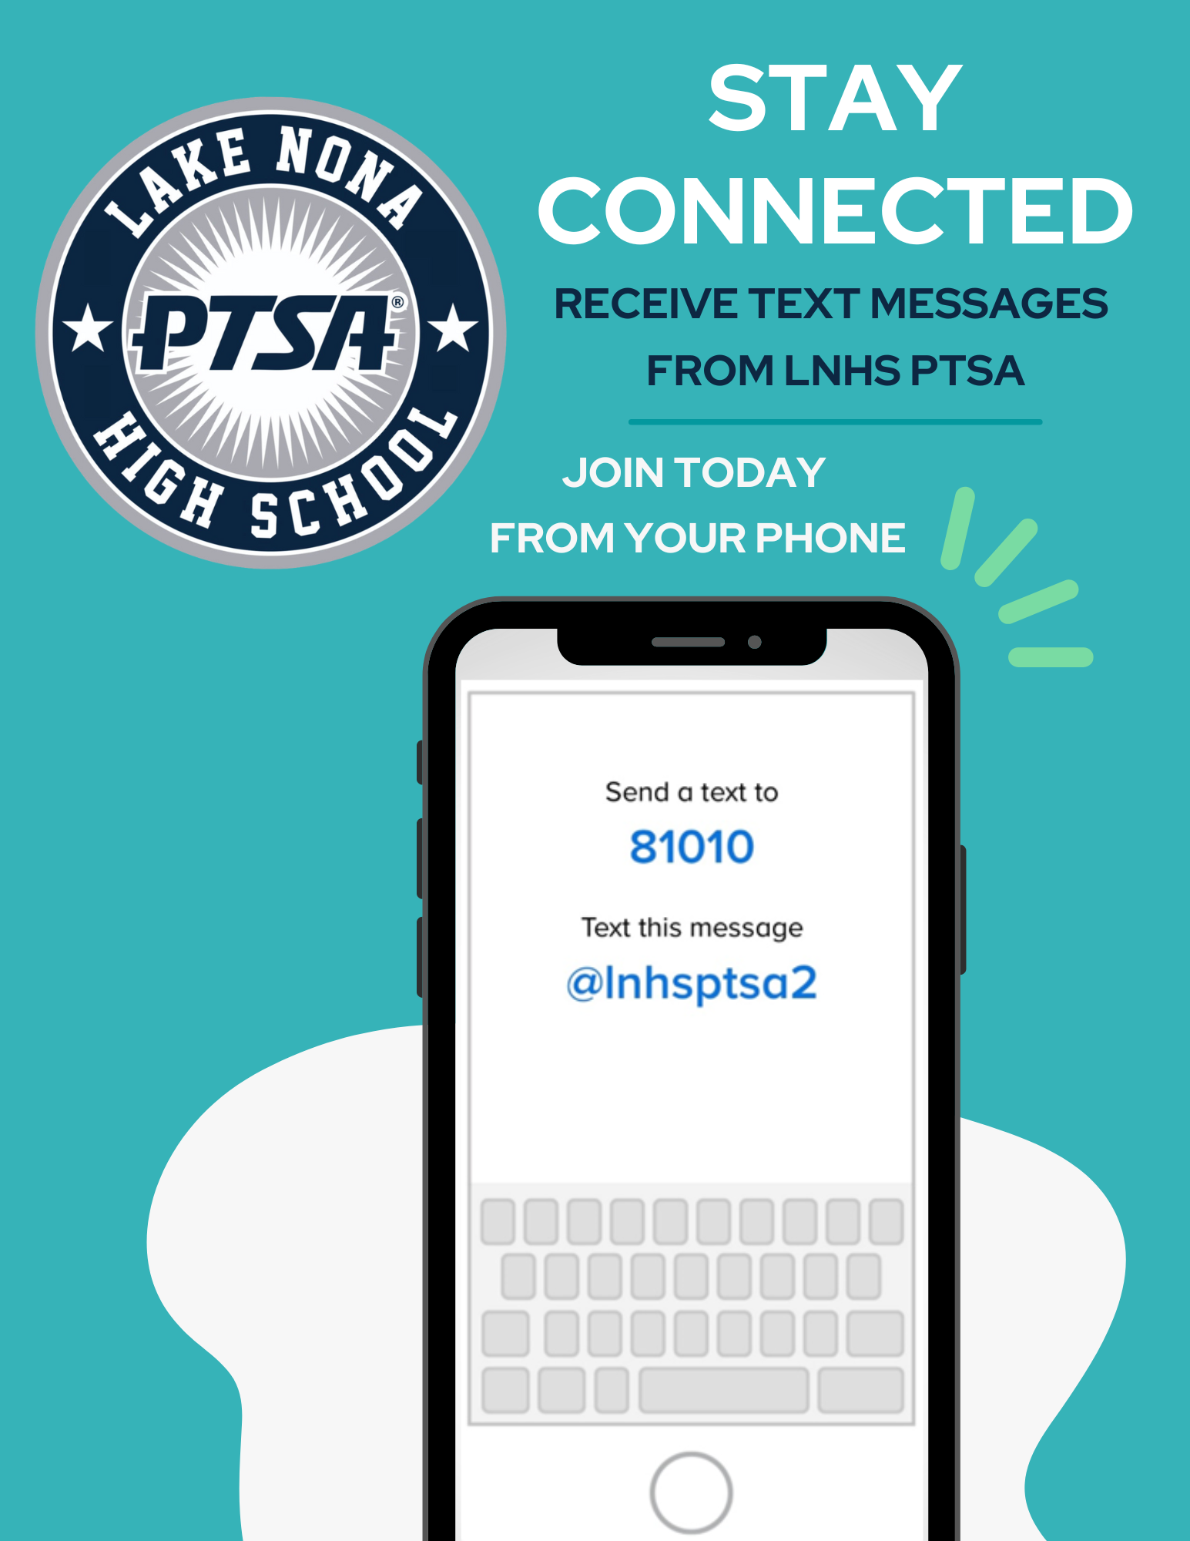
WELCOME
LNHS PTSA
GENERAL MEETING
WEDNESDAY
AUGUST 21, 2024
6:30PM
MEDIA CENTER
www.LNHSPTSA.com

Slide 2
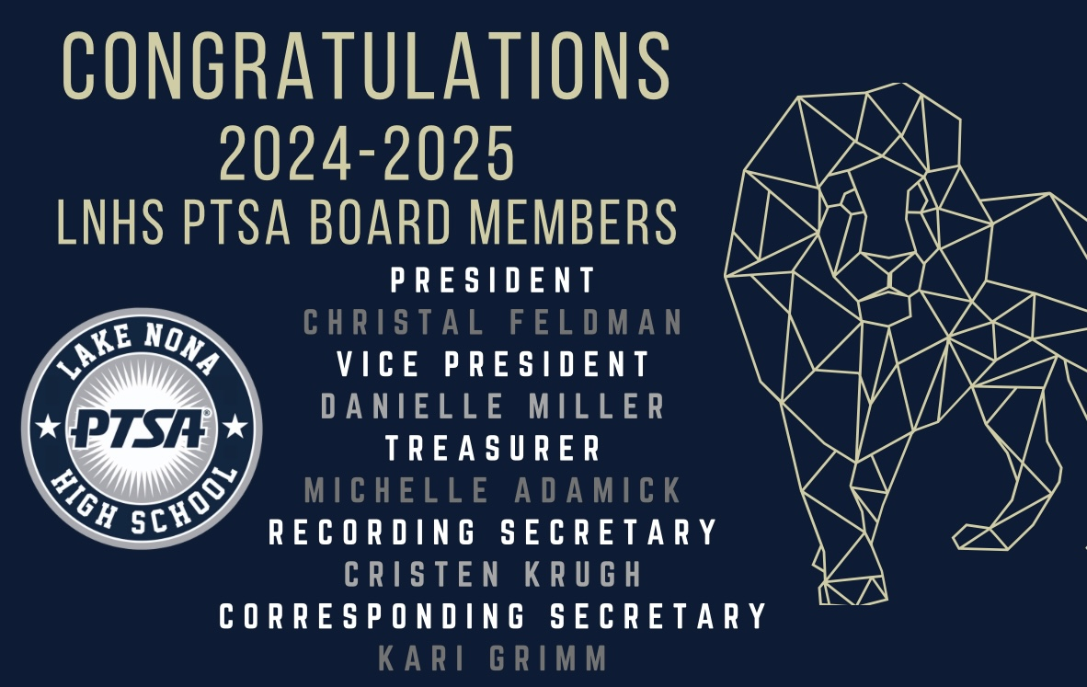

Slide 3
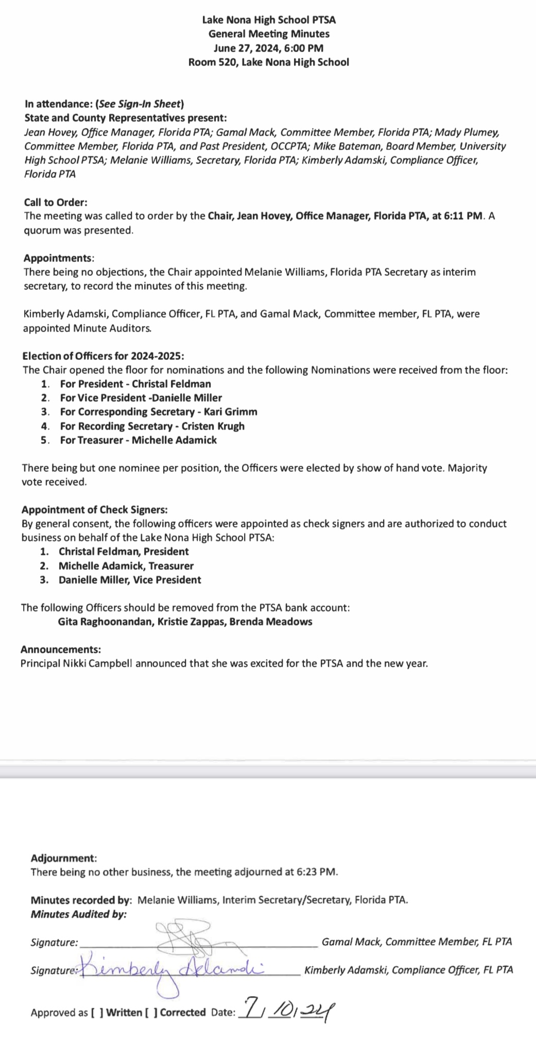

PAST MINUTES
JUNE 27, 2024
FOR APPROVAL
2024 - 2025 Election Meeting

Slide 4
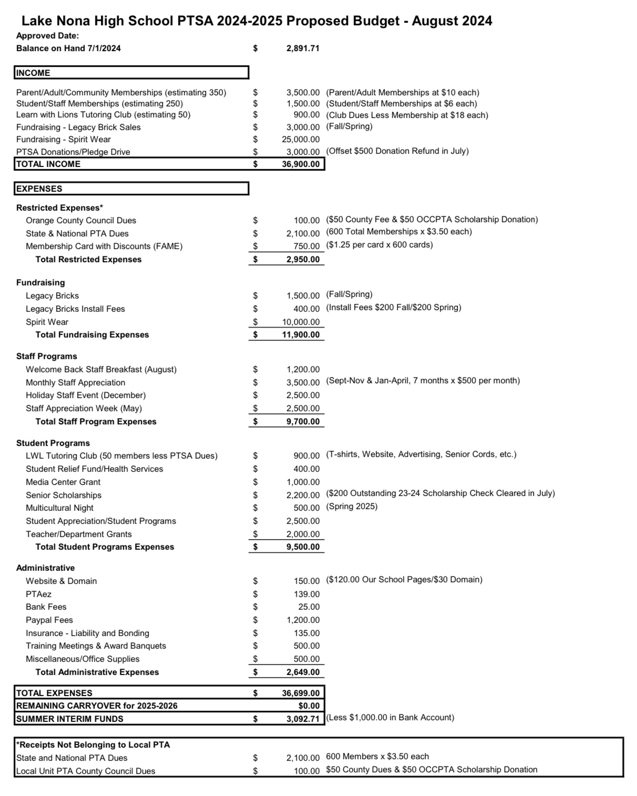
PROPOSED
2024 - 2025
ANNUAL BUDGET
FOR APPROVAL
2023-2024 Audit is Due August 31st
Starting Balance - $2,891.71
Less (2) Outstanding Checks that totaled $700.00
$2,191.71 (Keep $1,000 Balance in Bank Account)
$1,191.71

Slide 5




Slide 6


Slide 7



Slide 8


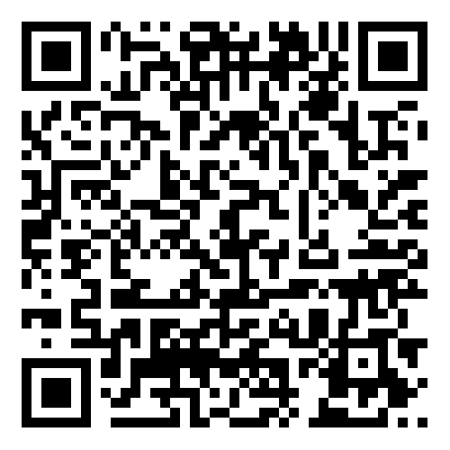

EMAIL - LNHSPTSA@gmail.com
WEBSITE - www.LNHSPTSA.com

Slide 9


Slide 10
